Slide 1

Lesson five
Shopping

Slide 2
Lesson objective
In this lesson we will learn…
words for fruits
words for clothes
words for colours
to buy fruits and clothes
to ask for prices
Chinese currency

Slide 3
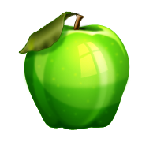

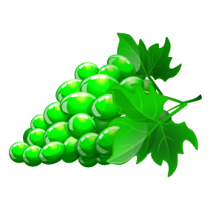
Fruits
píngguǒ
bōluó
cǎoméi
xiāngjiāo
lí
pútao

Slide 4
What are these? Match the words to the pictures.
píngguǒ bōluó
Lí pútao
Cǎoméi xiāngjiāo

Slide 5
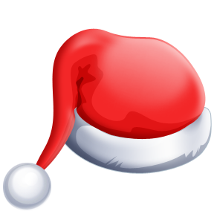
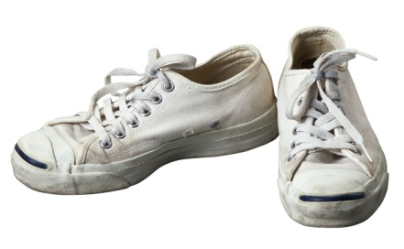
clothes
Shàngyī
top
kùzi
trousers
Màozi
hat
xié
shoes

Slide 6

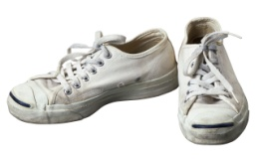
What are these? Match the words to the pictures.
màozi
Shàngyī
xié
kùzi

Slide 7

Colours
lánsè
Blue
hóngsè
Red
báisè
White
Huángsè
Yellow
lǜsè
Green
zǐsè
Purple

Slide 8
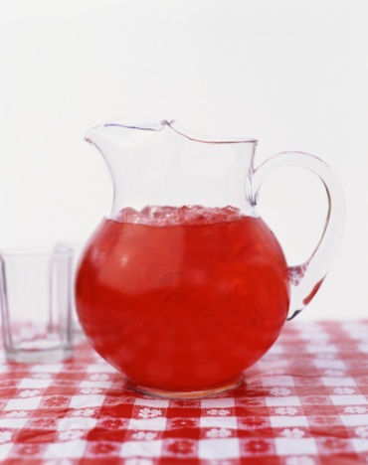
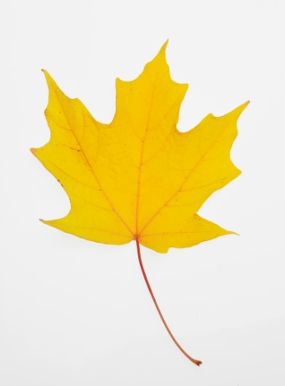
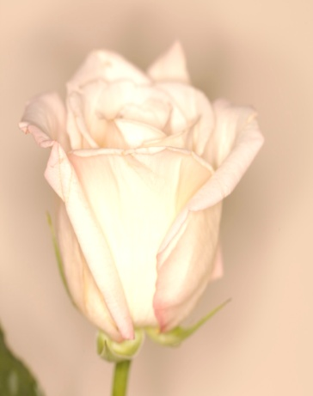
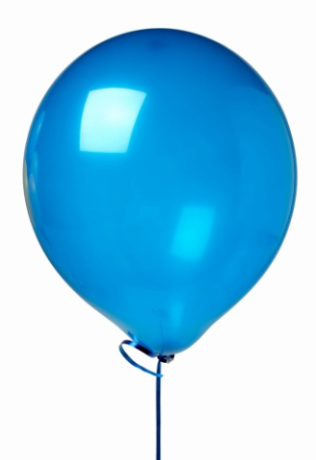
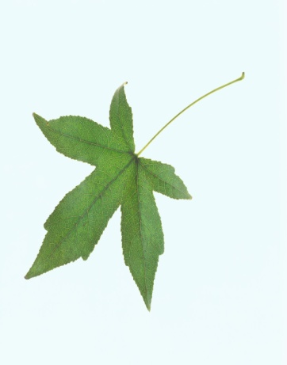
What colours are these?

Slide 9
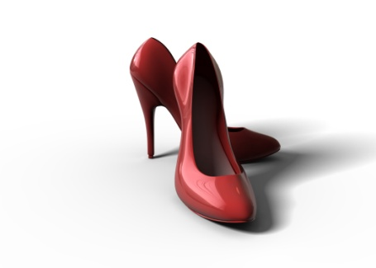
Listen to the example and Describe the pictures below
example:

Slide 10
Buy and sell
mǎi buy
mài sell

Slide 11
sentences
1. Wǒ mǎi kùzi 。
I buy trousers.
2. Wǒ bù mǎi shàngyī 。
I do not buy tops.
3. Wǒ mǎi píngguǒ 。
I buy apples.
4. Wǒ bù mǎi xiāngjiāo 。
I do not buy bananas.

Slide 12
Can you say the sentences in Chinese?
1. I buy strawberries.
2. I do not buy grapes.
3. I buy shoes.
4. I do not buy hat.

Slide 13
Check your answers
1. Wǒ mǎi cǎoméi 。
I buy strawberries.
2. Wǒ bù mǎi pútao 。
I do not buy grapes.
3. Wǒ mǎi xié 。
I buy shoes.
4. Wǒ bù mǎi màozi 。
I do not buy hat.

Slide 14
More sentences
1. Nǐ mài lí ma ？
Do you sell pears?
2. Wǒ mài lí 。
I sell pears.
3. Nǐ mài kùzi ma ？
Do you sell trousers?
4. Wǒ bù mài kùzi 。
I do not sell trousers.

Slide 15
Can you say these sentences in Chinese?
1. Do you sell hat?
2. I sell hat.
3. Do you sell bananas?
4. I do not sell bananas.

Slide 16
Check your answers
1. Nǐ mài màozi ma ？
Do you sell hat?
2. Wǒ mài màozi 。
I sell hat.
3. Nǐ mài xiāngjiāo ma ？
Do you sell bananas?
4. Wǒ bù mài xiāngjiāo 。
I do not sell bananas.

Slide 17
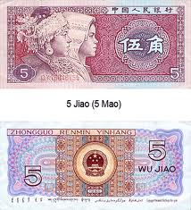
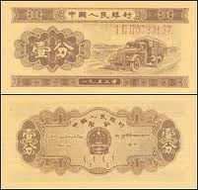
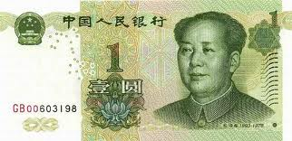
Chinese currency
yuán/kuài jiǎo/máo fēn

Slide 18
Say the following prices
¥1.36
yī yuán sān jiǎo liù fēn
yī kuài sān máo liù fēn
¥14.80
shísì yuán bā jiǎo
shísì kuài bā máo
¥3.05
sān yuán líng wǔ fēn
sān kuài líng wǔ fēn

Slide 19

Asking for price
Duōshao qián ？
How much?

Slide 20
Examples
Píngguǒ duōshao qián ？
How much are the apples?
Wǔ kuài sì máo 。
five kuai four mao.

Slide 21
Ask for the prices of the following items

Slide 22
Learn to write some characters
píngguǒ 苹果 apple
shàngyī 上衣 tops
duōshao 多少 how many/much
mǎi 买 buy
mài 卖 sell

Slide 23
Conclusion
  Today we have learned…
fruits including apple, pear, strawberry, banana, pineapple and grape;
clothes including top, trousers, shoes and hat;
colors including white, purple, green, red, yellow and blue;
to use ‘buy’ and ‘sell’;
to ask for prices;
Chinese currency;
to write a few more characters.

