Slide 1

House description

Slide 2
Lesson objectives
In this lesson we will learn:
Types of accommodations
To describe your home
To describe furniture in your home

Slide 3

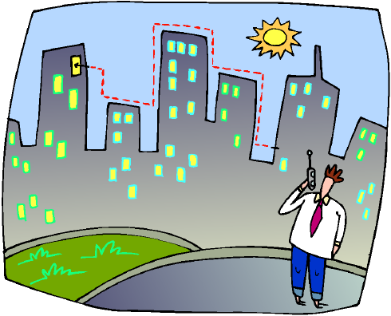
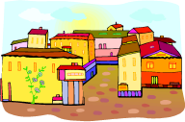
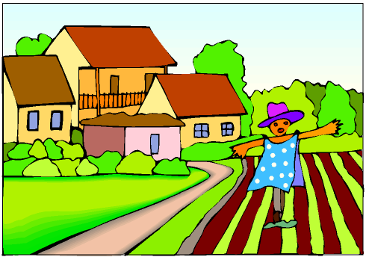
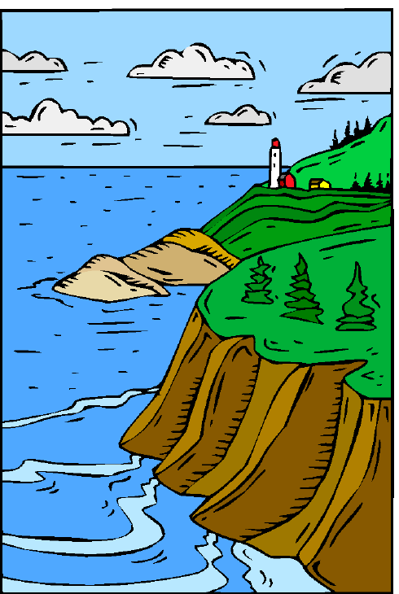
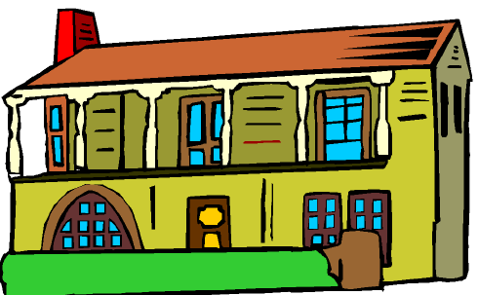
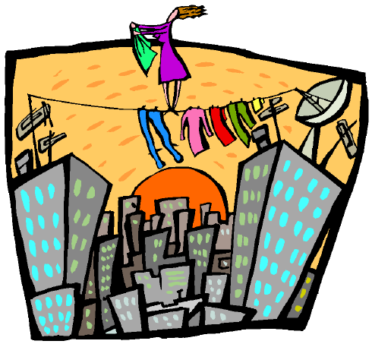
Where do you live? = ayna taskun? = أَيْنَ تَسْكُن؟
I live in = askunu fii = أَسْكُن فِي
الْمَدِينَة= almadiina
The city
الْقَرْيَة = alqarya
The village
الْبَادِيَة= albaadiya
The countryside
بِجَانِبِ الْبَحْر= bijaaninibi (a)lbaHr
By the sea side
مَنْزِل = manzil
A house
شَقَّة = shaqqa
A flat

Slide 4
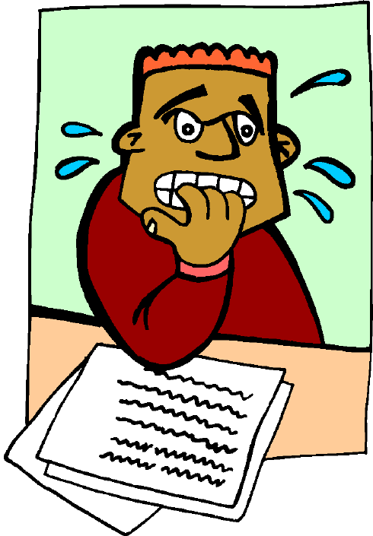
Test your memory by writing each word under its appropriate image
bijaaninibi (a)lbaHr - almadiina – alqarya – manzil – albaadiya - shaqqa

Slide 5

Reminder: the present tense
To live = yaskunu = يَسْكُنُ
(anaa) a (u) (naHnu) na (u)
(anta) ta (u) (antum) ta uun(a)
(anti) ta iin(a) (antunna) ta n(a)
(huwa) ya (u) (hum) ya uun(a)
(hiya) ta (u) (hunna) ya n(a)

Slide 6
أَيْنَ تَسْكُنِين؟
ayna taskuniin?
Where do you live?
أَسْكُنُ فِي مَنْزِل فِي الْمَدِينَة
askunu fii manzil fii (a)lmadiina
I live in a house in the city

Slide 7
وَأَنْتَ, أَيْنَ تَسْكُن؟
wa anta, ayna taskun?
And you, where do you live?
أَسْكُنُ فِي شَقَّة بِجَانِبِ الْبَحْر
askunu fii shaqqa bijaanibi (a)lbaHr
I live in a flat by the sea side

Slide 8

وَأَنْتَ, أَيْنَ تَسْكُن؟
wa anta, ayna taskun?

Slide 9
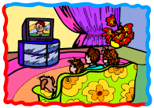

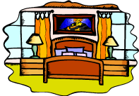
مَنْزِلِي= manzilii = my house
fii manzilii hunaaka… = in my house there is…
غُرْفَةُ الْجُلُوس= ghurfatu (a)ljuluus
Sitting room
غُرْفَةُ الطَّعَام= ghurfatu (a)TTa3aam
Dinning room
غُرْفَةُ النَّوْم= ghurfatu (a)nnawm
Bedroom

Slide 10
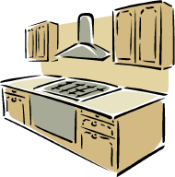
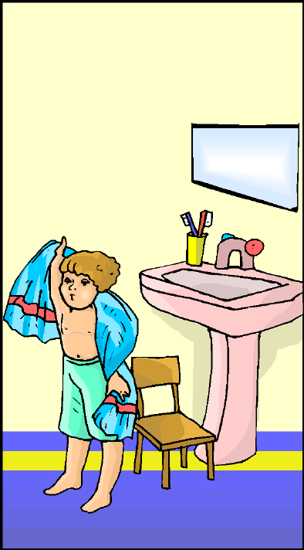
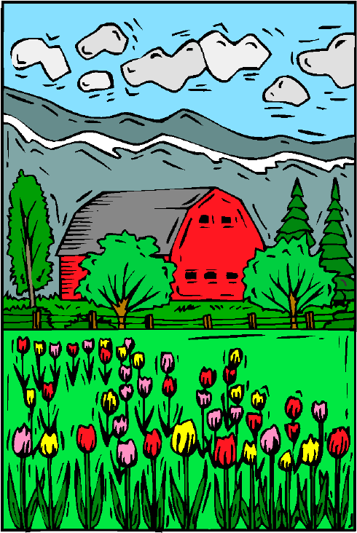
fii manzilii hunaaka… = in my house there is…
مَطْبَخ= maTbakh
Kitchen
حَمَّام= Hammaam
Bathroom
حَدِيقَة= Hadiiqa
Garden

Slide 11
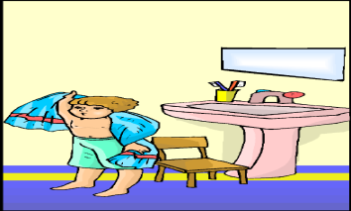

Test your memory
By putting the words under the right image
غُرْفَةُ الْجُلُوس - غُرْفَةُ النَّوْم - حَمَّام - حَدِيقَة – غُرْفَةُ الطَّعَام - مَطْبَخ

Slide 12
Talk about where you live and describe your house with the help of the phrases and sentences below.
askunu fii shaqqa fii (a)lmadiina
I live in a flat in town
fii manzilii hunaaka…
In my house there is…
hunaaka ayDan…
There is also…
maTbakh Saghiir
A small kitchen
thalaath ghuraf nawm
Three bedrooms
Hammaam kabiir
A big bathroom
fii shaqqatii hunaaka…
In my flat there is…
Hadiiqa jamiila
A beautiful garden
ghurfat Ta3aam
Dinning room

Slide 13



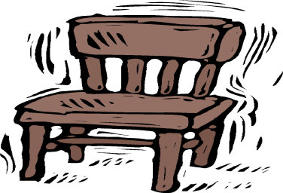

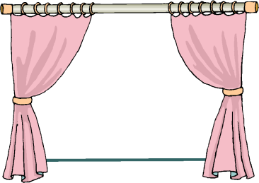
Furniture = athaath = أَثَاث
كَنَبَة = kanaba
Sofa
مَائِدَة = maa’ida
Table
سَرِير = sariir
Bed
كُرْسِي/ كَرَاسِي
karaasii/ kursiy
Chairs / chair
مَكْتَب = maktab
Desk
سَتَائِر = sataa’ir
curtains

Slide 14

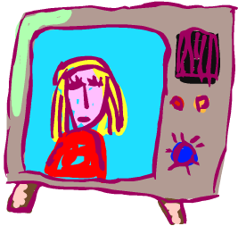


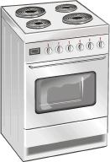
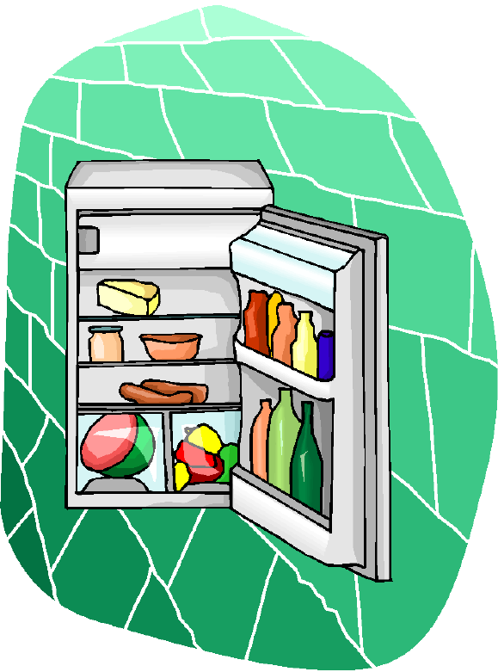
صُورَة = Suura
Picture
تِلْفَاز = tilfaaz
TV
حَاسُوب = Hasuub
Computer
مِزْهَرِيَّة = mizhariyya
Vase
فُرْن = furn
Oven
ثَلَّاجَة = thallaaja
Fridge

Slide 15

Join the right word to the right image
كُرْسِي/ كَرَاسِي
karaasii/ kursiy
مَكْتَب = maktab
سَرِير = sariir
كَنَبَة = kanaba

Slide 16

صُورَة = Suura
مَائِدَة = maa’ida
تِلْفَاز = tilfaaz
سَتَائِر = sataa’ir

Slide 17
مِزْهَرِيَّة = mizhariyya
ثَلَّاجَة = thallaaja
حَاسُوب = Hasuub
فُرْن = furn

Slide 18
Describe what is in your bedroom and other rooms in your house/flat by using the examples below and examples of your own
fii ghurfat aljuluus yuujadu
In the sitting room there is (found)...
fii ghurfatii hunaaka…
In my bedroom there is...
sariir bijaanib almaktab
Bed next to the desk
mizhariyya 3alaa (a)lmaa’ida
A vase on
the table
sataa’ir zarqaa’
Blue curtains
kanaba jadiida amaama (a)ttilfaaz
A new sofa
in front of TV
maa’ida wa karaasii
A table and chairs

Slide 19

Listening
Listen to Marwa describing her house and correct the following statements
1- Marwa lives in a house in a village
2- Marwa’s bedroom is small
3- In her bedroom there is a chair in front of the bed
4- In her bedroom there are black curtains
5- There is a computer and a vase in the sitting room
6- There is a table and chairs in the kitchen

Slide 20

Homework
Write in the Arabic script about where you live and describe in detail your house/flat

